Slide 1
My Spiritual Hero and Me series - part 2
Oyinlola Ayandokun
16 February 2025

Slide 2
Hero
Definition
Influence
Shaping
Challenge &
encouragement

Slide 3
Definitions of a Hero
a person who is admired for doing something very brave or having outstanding achievements;
a person who is admired for their courage,, or noble qualities;
the main character in a book, play or movie, who is usually good;
someone who you admire very much.

Slide 4
The Word became flesh and dwelt among us, and we beheld His glory, the glory as of the only begotten of the Father, full of grace and truth. John 1:14 NKJV
For God called you to do good, even if it means suffering, just as Christ suffered for you. He is your example, and you must follow in His steps. 1 Peter 2:21 NLT

Slide 5
Influence
Hannah: 1 Samuel 1 & 2 – A woman of grace and favour.
v15. Not so, my lord,” Hannah replied, “I am a woman who is deeply troubled. I have not been drinking wine or beer; I was pouring out my soul to the Lord. Do not take your servant for a wicked woman; I have been praying here out of my great anguish and grief.” 1Sam. 1:15-16

Slide 6
Influence (cont’d)
Ruth: Book of Ruth – A life that identified with God and His people
But Ruth replied, “Don’t urge me to leave you or to turn back from you. Where you go, I will go and where you stay, I will stay. Your people will be my people and your God (will be) my God. Ruth 1:16 NIV

Slide 7
Influence (cont’d)
Joseph: Genesis 37 to 44 – A man of dreams
As for you, you meant evil against me, but God meant it for good
Gen. 50:20a (ESV);
No temptation has overtaken you except such as is common to man; but God is faithful, who will not allow you to be tempted beyond what you are able, but with the temptation will also make the way of escape, that you may be able to bear it.“
1 Cor. 10:13 (NKJV); See also Jer. 29:11&12

Slide 8
Influence (cont’d)
Virtuous woman – Proverbs. 31:10-31
She provides food for her household v.15
She extends her hand to the poor v. 20
Strength and honour are her clothing v. 25
She opens her mouth with wisdom v. 26
On her tongue is the law of kindness v. 26
Her children rise up and call her blessed v. 28
Her husband also, and he praises her v. 28
A woman who fears the Lord v. 30

Slide 9
Influence (cont’d)
Therefore, whether you eat or drink, or whatever you do, do all to the glory of God. 1 Corinthians 10:31
But you are a chosen generation, a royal priesthood, a holy nation, His own special people, that you may proclaim the praises of Him who called you out of darkness into His marvelous light. 1 Peter 2:9
His divine power has given me everything we need for a godly life through our knowledge of him who called us by his own glory and goodness. 2 Peter 1:3

Slide 10
Life of Hannah
Hannah means "Grace," signifying God's mercy and favour.
Her story is one of faith, patience and perseverance.
Her story encourages us to wait with hope;
Hannah was a woman of prayer
Hannah makes a sacrificial vow to God.

Slide 11
Challenge & Encouragement
Worship
No one is holy like the Lord, for there is none besides You, nor is there any rock like our God, 1 Sam. 2:2 (see verses 1-10)
Asking for and offering forgiveness
And she said to him “Pardon me, my lord. As surely as you live, I am the woman who stood here beside you praying to the Lord.”
1 Sam 1:26
Sacrifice
And she made a vow, saying, “Lord Almighty, if you will only look on your servant’s misery and remember me, and not forget your servant but give her a son, then I will give him to the Lord for all the days of his life.
1 Sam 1:11- NIV
And she said, “Let your maidservant find favour in your sight.” So the woman went her way and ate, and her face was no longer sad.
1 Sam 1:18
Hope & Faith

Slide 12


Slide 13
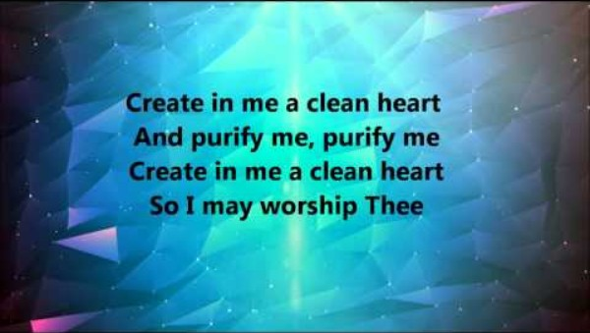

Slide 14
Prayers
Reflection
Search me, O God, and know my heart: try me, and know my thoughts: And see if there be any wicked way in me, and lead me in the way everlasting. Ps 139:23-24
Hope & Trust in God
“For by strength no man shall prevail”.1Sam 2:9b
All to God’s Glory
Therefore, whether you eat or drink, or whatever you do, do all to the glory of God. 1 Corinthians 10:31

Slide 15
I will set my face to seek the Lord
I will set my face to seek the Lord
Give my full attention to my God
I will listen for His voice...
My Wonderful Counsellor,
My Teacher, Reminder, Revealer,
My Healer, My Strengthener, Repairer, Refiner, My Jesus, My Saviour
My wonderful God
Forerunner and Finisher, My Conqueror
Deliverer, Restorer, My Hammer, My Fire Uniter, Redeemer, My Jesus, My Saviour My wonderful God
Creator, Defender, My Maker, Instructor Commander, My Warrior, My Shelter
My Helper, My Leader
My Jesus, My Saviour
My wonderful God
My Shepherd, My Gatherer, Refresher, Rewarder, Protector, Inspirer, Provider
My Portion, Forever, My Jesus,
My Saviour, My Wonderful God.
Godfrey Birtill

